Slide 1
Unit-2
Supervised Learning
Prepared By: Arjun Sing Saud
Asst. Prof. CSCSIT, TU

Slide 2
Gradient Descent
Gradient descent is an optimization algorithm used to minimize some convex function by iteratively moving in the direction of steepest descent as defined by the negative of the gradient.
In machine learning, we use gradient descent to update the parameters of our model. Parameters refer to coefficients in Logistic Regression and weights in neural networks.

Slide 3
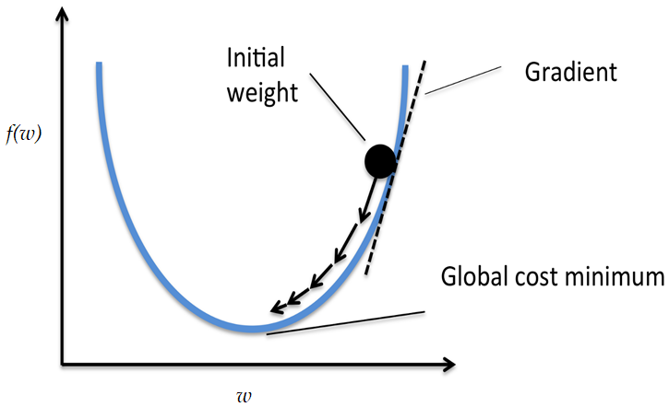
Gradient Descent

Slide 4
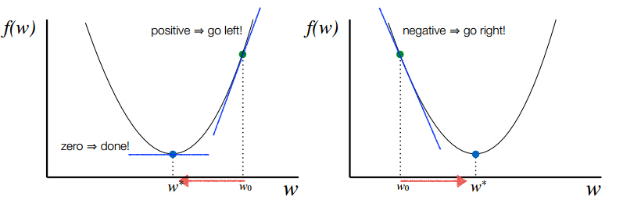
Gradient Descent

Slide 5
Gradient Descent
If f is function to be minimized (cost function), Gradient descent changes the parameters of learning model iteratively as below:
GD simply measures the change in all weights with regard to the change in error. We can also think of a gradient as the slope of a function.

Slide 6
Gradient Descent
Said it more mathematically, a gradient is a partial derivative with respect to its inputs.
The higher the gradient, the steeper the slope and the faster a model can learn. But if the slope is zero, the model stops learning.
How big the steps are that Gradient Descent takes into the direction of the local minimum are determined by the learning rate.

Slide 7
Gradient Descent
With a high learning rate we can cover more ground each step, but we risk overshooting the lowest point.
A low learning rate is more precise, but calculating the gradient is time-consuming, so it will take us a very long time to get to the bottom.

Slide 8
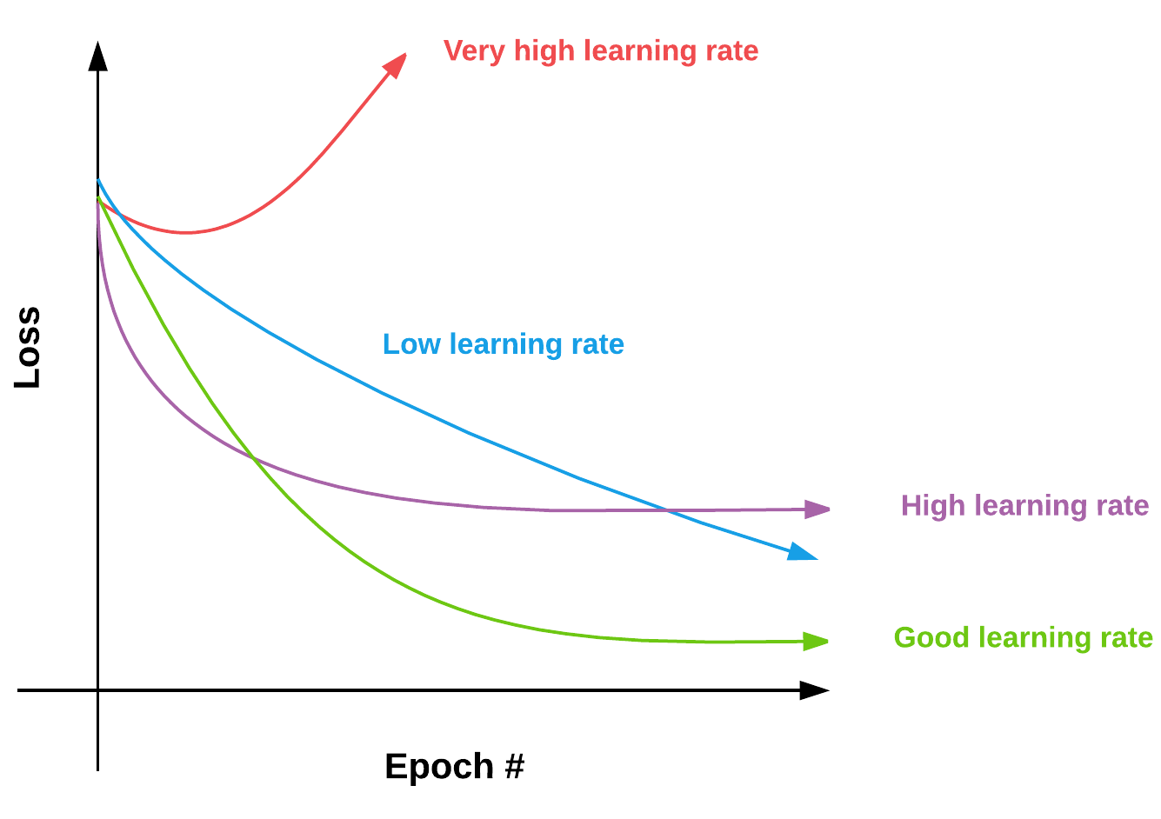
Gradient Descent

Slide 9
Gradient Descent Variations
Gradient descent is an optimization algorithm often used for finding the weights or coefficients of machine learning algorithms.
It uses the error on the predictions to update the model in such a way as to reduce the error.
The goal of the algorithm is to find model parameters (e.g. coefficients or weights) that minimize the error of the model on the training dataset.

Slide 10
Gradient Descent Variations
It does this by making changes to the model that move it along a gradient or slope of errors down toward a minimum error value. This gives the algorithm its name of “gradient descent.”
The three main flavors of gradient descent are batch, stochastic, and mini-batch.

Slide 11
Gradient Descent Variations
Batch Gradient Descent
Batch gradient descent, computes the gradient of the cost function w.r.t. the parameters w for the entire training dataset:
As we need to calculate the gradients for the whole dataset perform just one update, batch gradient descent is computationally fast. However, it is intractable for datasets that don't fit in memory.

Slide 12
Gradient Descent Variations
Batch Gradient Descent
Batch gradient descent also doesn't allow us to update our model online, i.e. with new examples on-the-fly.
Pseudocode of batch gradient descent looks like below:
for i in range(#epochs):
grad = evaluategradient(data, para)
para= para – learning_rate * grad

Slide 13
Gradient Descent Variations
Batch Gradient Descent
Batch gradient descent is guaranteed to converge to the global minimum for convex error surfaces and to a local minimum for non-convex surfaces.

Slide 14
Gradient Descent Variations
Stochastic Gradient Descent (SGD)
Stochastic gradient descent (SGD) in contrast performs a parameter update for each training example x^{(i)} and label y^{(i)}. Therefore, learning happens on every example.
The term stochastic indicates that the one example comprising each batch is chosen at random.

Slide 15
Gradient Descent Variations
Stochastic Gradient Descent (SGD)
Stochastic gradient descent allow us to update our model online.
Pseodocode for Stochastic Gradient Descent looks like below:
for i in range(#epochs):
np.random.shuffle(data)
for d in data:
grad = compute_gradient(d, params)
params = params — learning_rate * grad

Slide 16
Gradient Descent Variations
Stochastic Gradient Descent (SGD)
SGD updates the model much frequently, which is more computationally expensive than other configurations of gradient descent.
Thus it takes significantly longer to train models on large datasets. At the same time we lose speedup due to Vectorization.
These frequent updates can result in a noisy gradient signal, which may cause the model parameters jump around (have a higher variance over training epochs).

Slide 17
Gradient Descent Variations
Stochastic Gradient Descent (SGD)
At the same time this behavior helps to jump to another minima.
This ultimately complicates convergence to the exact minimum, as SGD will keep overshooting.

Slide 18
Gradient Descent Variations
Mini-Batch Gradient Descent
Mini-batch gradient descent is a variation of the gradient descent algorithm that splits the training dataset into small batches that are used to calculate model error and update model coefficients.
Implementations may choose to sum the gradient over the mini-batch or take the average of the gradient which further reduces the variance of the gradient.

Slide 19
Gradient Descent Variations
Mini-Batch Gradient Descent
Pseudocode of Mini-batch gradient descent looks like below:
for i in range(#epochs):
np.random.shuffle(data) for batch in data: grad = compute_gradient(batch, params) params = params — learning_rate * grad

Slide 20
Gradient Descent Variations
Mini-Batch Gradient Descent
Mini-batch gradient descent takes the best of both Batch Gradient and SGD.
Reduces the variance of the parameter updates, which can lead to more stable convergence
Performs less frequent parameter updates and hence is not much time consuming.
Mini-batch gradient descent is the recommended variant of gradient descent for most applications.

Slide 21
Gradient Descent Variations
Comments on Batch-Size
Mini-batch requires the configuration of an additional batch size Hyperparameter for the learning algorithm.
Small values results in faster learning process at the cost of noise in the training process.
Large values results in slow learning process with accurate estimates of the error gradient.

Slide 22
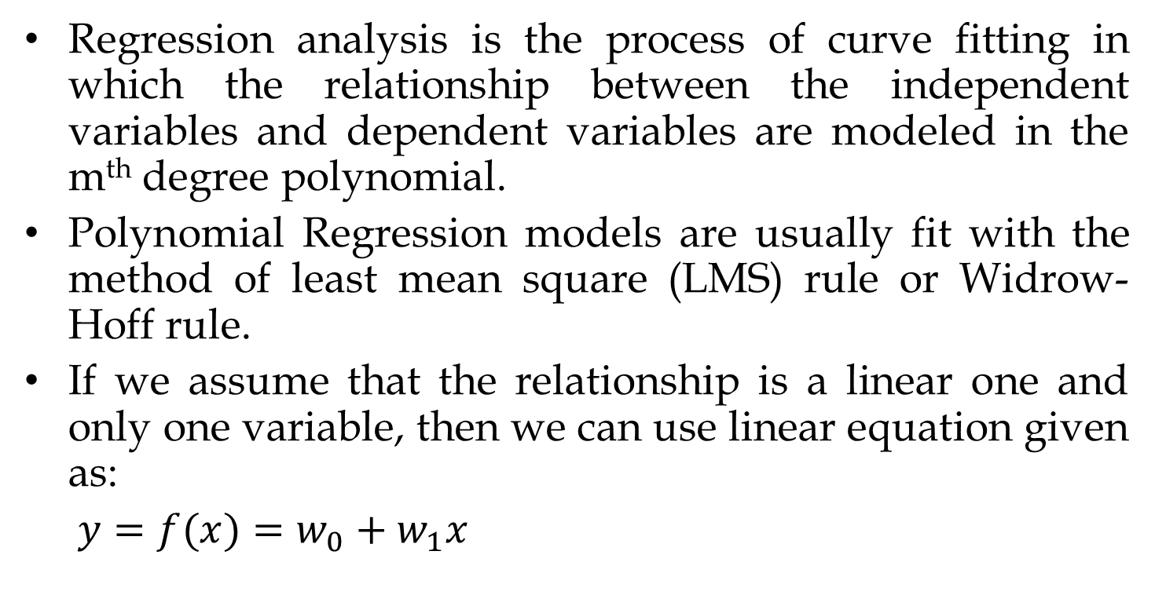
Linear Regression
Regression analysis is the process of curve fitting in which the relationship between the independent variables and dependent variables are modeled in the m^{th} degree polynomial.
Polynomial Regression models are usually fit with the method of least mean square (LMS) rule or Widrow-Hoff rule.
If we assume that the relationship is a linear one and only one variable, then we can use linear equation given as:
$y=f(x)=w_{0}+w_{1}x$

Slide 23
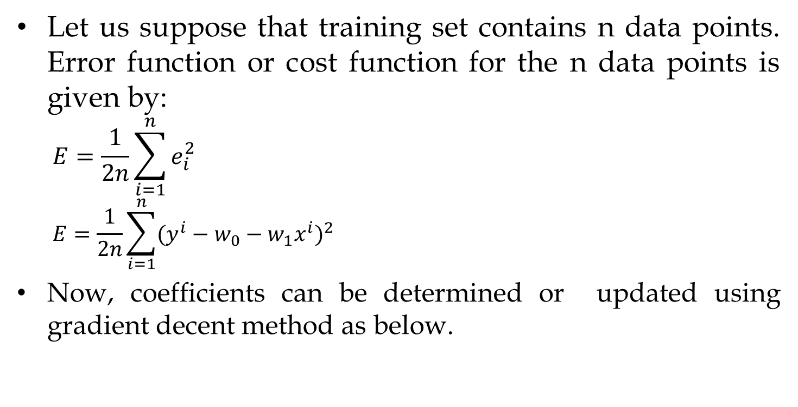
Linear Regression
Let us suppose that training set contains n data points. Error function or cost function for the n data points is given by:
$$E=\frac{1}{2n}\sum_{i=1}^{n}{e_{i}^{2}}$$
$$E=\frac{1}{2n}\sum_{i=1}^{n}{{(y^{i}−w_{0}−w_{1}x^{i})}^{2}}$$
Now, coefficients can be determined or updated using gradient decent method as below.

Slide 24

Linear Regression
$w_{0}=w_{0}−α\frac{∂E}{∂w_{0}} =w_{0}+α\frac{1}{n}\sum_{i=1}^{n}{{{(y}_{i}−w}_{0}−w_{1}x_{i}})$
$$w_{1}=w_{1}−α\frac{∂E}{∂w_{1}} =w_{1}+α\frac{1}{n}\sum_{i=1}^{n}{{{(y}_{i}−w}_{0}−w_{1}x_{i}})x_{i}$$

Slide 25
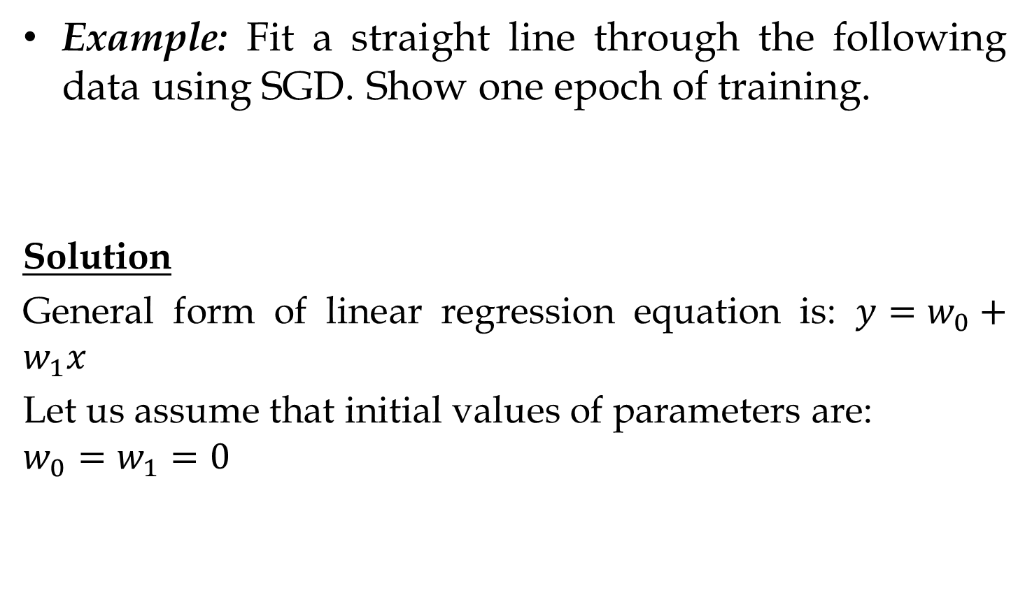
Linear Regression
Example: Fit a straight line through the following data using SGD. Show one epoch of training.
Solution
General form of linear regression equation is: $y=w_{0}+w_{1}x$
Let us assume that initial values of parameters are:
$$w_{0}=w_{1}=0$$
x | 1 | 2 | 3 | 4
f(x) | 3 | 5 | 7 | 9

Slide 26
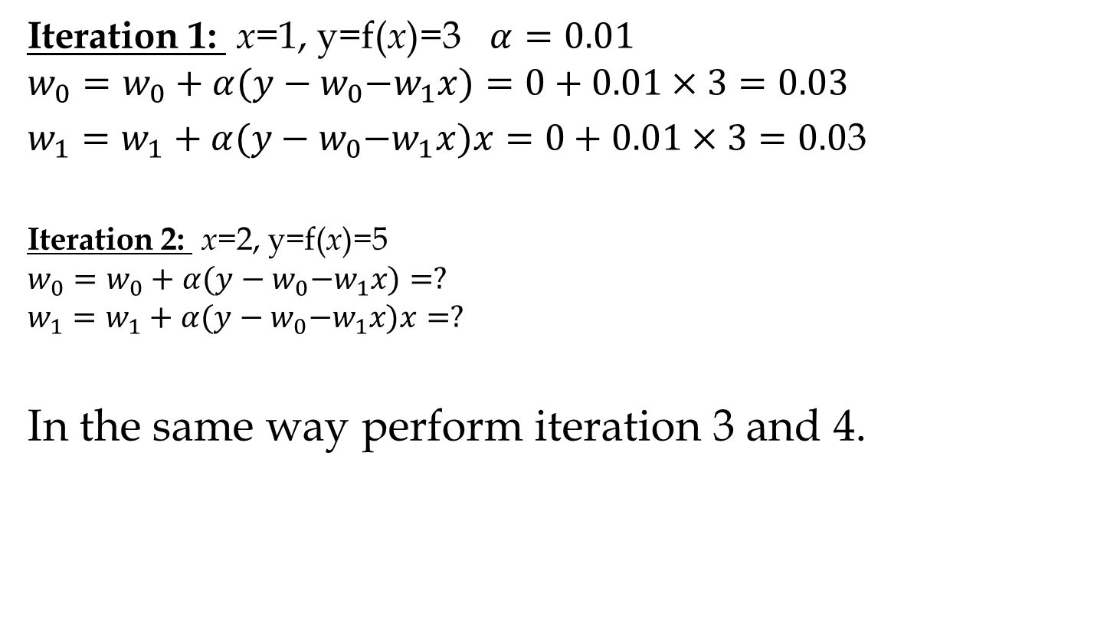
Linear Regression
Iteration 1: x=1, y=f(x)=3 $α=0.01$
$$w_{0}=w_{0}+α{(y−w}_{0}−w_{1}x)=0+0.01×3=0.03$$
$w_{1}=w_{1}+α{(y−w}_{0}−w_{1}x)x=0+0.01×3=0.0$3
Iteration 2: x=2, y=f(x)=5
$$w_{0}=w_{0}+α{(y−w}_{0}−w_{1}x)=?$$
$$w_{1}=w_{1}+α{(y−w}_{0}−w_{1}x)x=?$$
In the same way perform iteration 3 and 4.

Slide 27
Linear Regression
CW
Derive Weight Update rule for Linear Regression for two variables.
Example: Fit a straight line through the following data using SGD. Show one epoch of training.
x₁ | 1 | 2 | 1 | 3
x₂ | 1 | 1 | 2 | 3
y=f(x) | 3 | 5 | 2 | 5

Slide 28
Matrix Derivatives
Let A be a m×n matrix and f : R^{m×n} → R be a mapping function from mxn matrices to a real number.
Now, gradient of f with respect to A is also a m×n matrix and is given as below.

Slide 29
Matrix Derivatives

Slide 30

Matrix Derivatives
Example: Consider the following 2×2 matrix,
Let
$∇_{A}f_{A}=$

Slide 31
Matrix Derivatives
For an n x n matrix A, the trace of A is defined to be the sum of its diagonal entries:
If a is a real number (i.e. a 1x1 matrix), then tra = a.
The trace operator has the property that for two matrices A and B such that AB is square, we have trAB = trBA.

Slide 32
Matrix Derivatives
CW: verify that trAB = trBA.
As corollaries of this, we also have.
trABC=trCAB=trBCA
trABCD=trDABC=trBCDA
CW: prove that above corollaries are true.

Slide 33
Matrix Derivatives
If, A and B are square matrices, and a is a real number then following properties of the trace operator exhibits following properties.
trA=trA^{T}
tr(A+B)=trA+trB
traA=atrA
CW: prove that above mentioned properties of trace operator are true.

Slide 34
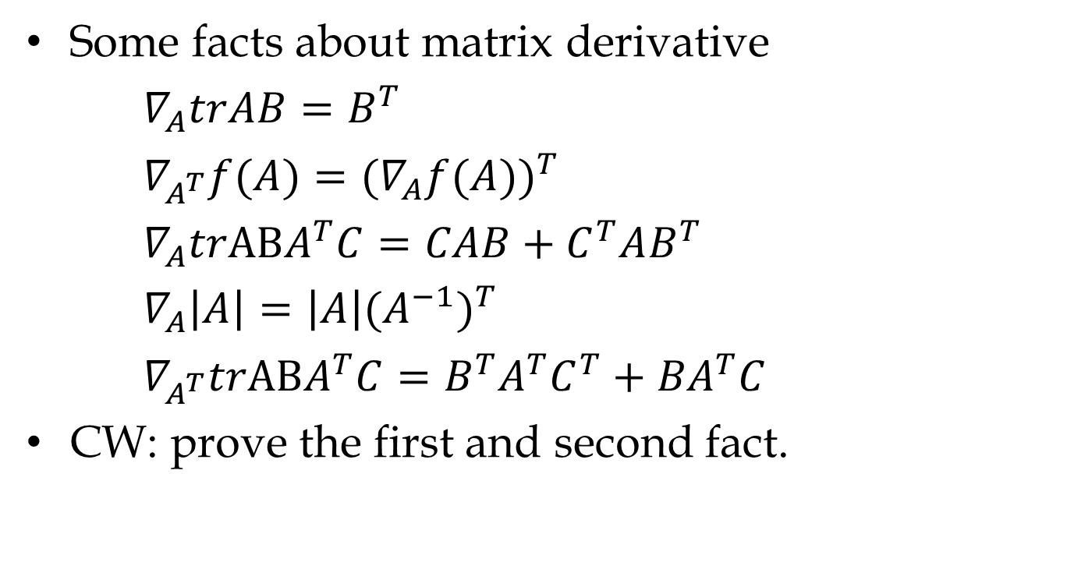
Matrix Derivatives
Some facts about matrix derivative
$∇_{A}trAB=B^{T}$
$∇_{A^{T}}f(A)={{(∇}_{A}f(A))}^{T}$
$∇_{A}trABA^{T}C=CAB+C^{T}AB^{T}$
$∇_{A}\left|A\right|=\left|A\right|{(A^{−1})}^{T}$
$∇_{A^{T}}trABA^{T}C=B^{T}A^{T}C^{T}+{BA}^{T}C$
CW: prove the first and second fact.

Slide 35
Deriving Normal Equations
Giving a training set, Let X be the mxn matrix that contains the training examples’ input values in its rows. Also, let be the m-dimensional vector containing all the target values from the training set.

Slide 36
Deriving Normal Equations
Since,
Now, loss function can be written as:

Slide 37
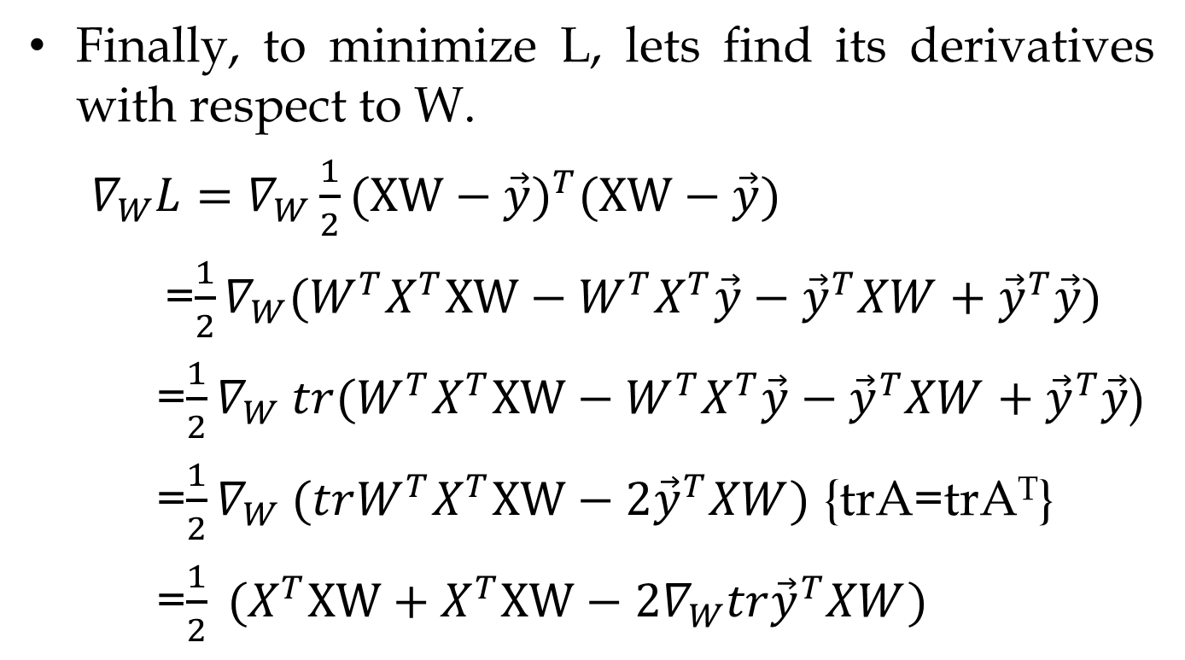
Deriving Normal Equations
Finally, to minimize L, lets find its derivatives with respect to W.
$∇_{W}L=∇_{W}\frac{1}{2}{(XW−\vec{y})}^{T}(XW−\vec{y})$
=$\frac{1}{2}∇_{W}(W^{T}X^{T}XW−W^{T}X^{T}\vec{y}−{\vec{y}}^{T}XW+{\vec{y}}^{T}\vec{y})$
=$\frac{1}{2}∇_{W} tr(W^{T}X^{T}XW−W^{T}X^{T}\vec{y}−{\vec{y}}^{T}XW+{\vec{y}}^{T}\vec{y}$)
=$\frac{1}{2}∇_{W} (trW^{T}X^{T}XW−2{\vec{y}}^{T}XW)$ {trA=trA^{T}}
=$\frac{1}{2} (X^{T}XW+X^{T}XW−2∇_{W}tr{\vec{y}}^{T}XW)$

Slide 38
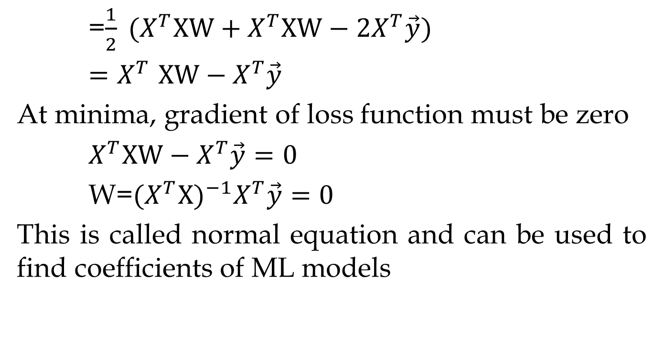
Deriving Normal Equations
=$\frac{1}{2} (X^{T}XW+X^{T}XW−2X^{T}\vec{y})$
${=X}^{T}XW−X^{T}\vec{y}$
At minima, gradient of loss function must be zero
$X^{T}XW−X^{T}\vec{y}=0$
W=${(X^{T}X)}^{−1}X^{T}\vec{y}=0$
This is called normal equation and can be used to find coefficients of ML models

Slide 39
Logistic Regression
Logistic regression is one of the most popular machine learning algorithms for binary classification. This is because it is a simple algorithm that performs very well on a wide range of problems.
We want to predict a variable , where 0 is called negative class, while 1 is called positive class. Such task is known as binary classification.

Slide 40
Logistic Regression
The heart of the logistic regression technique is logistic function and is defined as:
Logistic function transforms the input into the range [0, 1]. Smallest negative numbers results in values close to zero and the larger positive numbers results in values close to one.
If there are two input variable, logistic regression has two coefficients just like linear regression.

Slide 41
Logistic Regression
Unlike linear regression, the output is transformed into a probability using the logistic function:
If the probability is > 0.5 we can take the output as a prediction for the class 1, otherwise the prediction is for the class 0.
The job of the learning algorithm will be to discover the best values for the coefficients (w₀, w₁, and w₂) based on the training data.

Slide 42
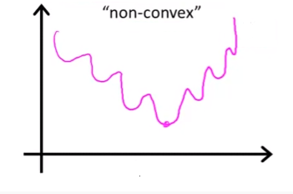
Logistic Regression Cost Function
Unfortunately we can’t use the cost function MSE in logistic regression. It’s because our prediction function is non-linear (due to sigmoid transform).
Squaring this prediction as we do in MSE results in a non-convex function with many local minimums. If our cost function has many local minimums, gradient descent may not find the optimal global minimum.

Slide 43
Logistic Regression Cost Function
Given the training set
we want
For logistic regression, we use following loss function or error function
In case y=1, the output (the cost to pay) approaches to 0 as approaches to 1. Conversely, the cost to pay grows to infinity as approaches to 0.

Slide 44
Logistic Regression Cost Function
This is a desirable property: we want a bigger penalty as the algorithm predicts something far away from the actual value. the same intuition applies when y=0.
Thus, cost function for Logistic regression is given as:

Slide 45
Logistic Regression GD/Derivatives

Slide 46
Logistic Regression GD/Derivatives

Slide 47
Logistic Regression
Thus, parameters of Logistic Regression are updated as below:

Slide 48
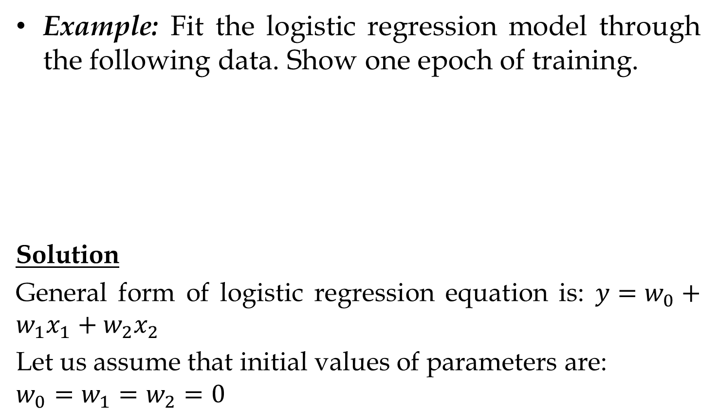
Logistic Regression
Example: Fit the logistic regression model through the following data. Show one epoch of training.
Solution
General form of logistic regression equation is: $y=w_{0}+w_{1}x_{1}+w_{2}x_{2}$
Let us assume that initial values of parameters are:
$$w_{0}=w_{1}=w_{2}=0$$
x₁ | x₂ | Class(y)
0.78 | 0.69 | 1
0.67 | 1.00 | 1
0.00 | 0.00 | 0
0.22 | 0.14 | 0

Slide 49
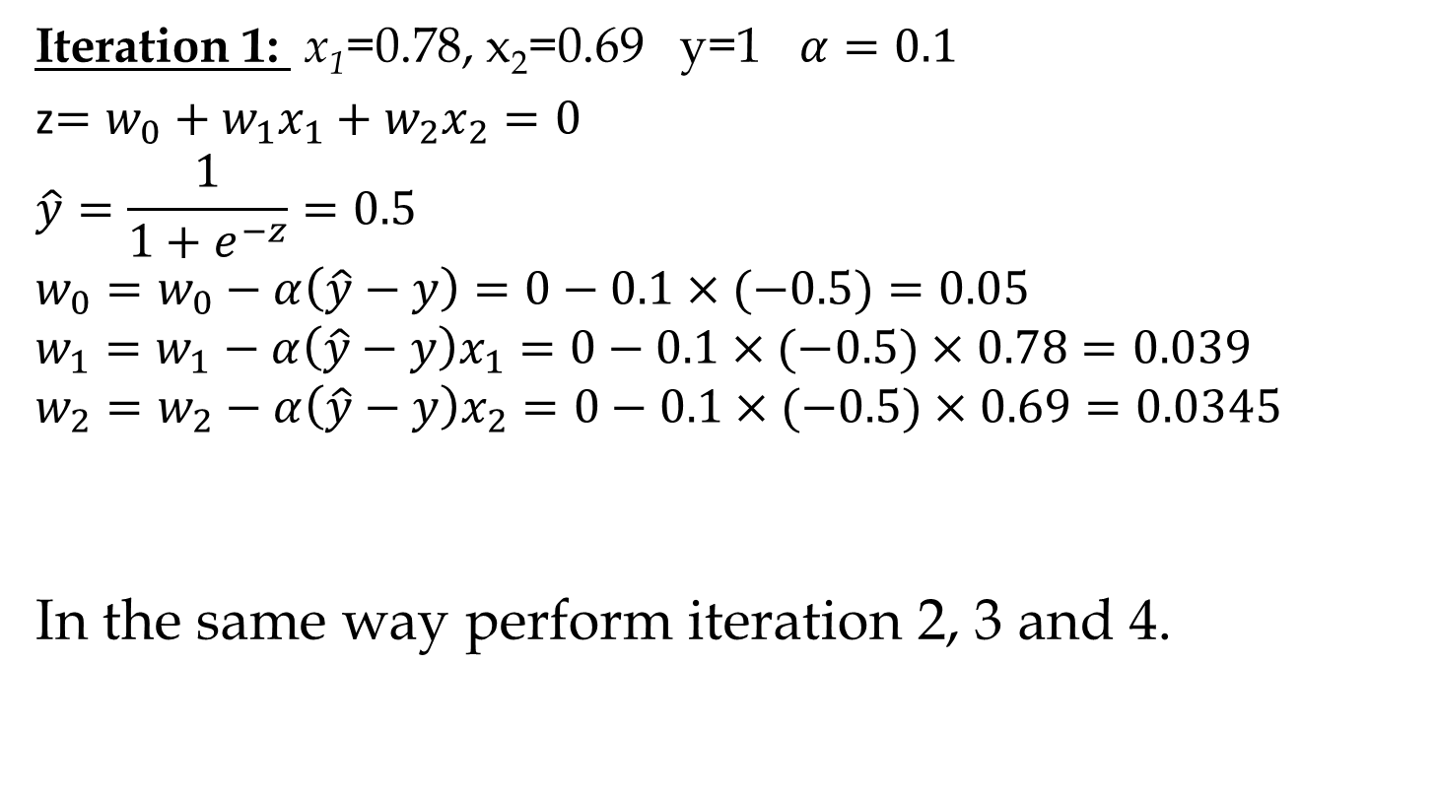
Logistic Regression
Iteration 1: x₁=0.78, x₂=0.69 y=1 $α=0.1$
z$=w_{0}+w_{1}x_{1}+w_{2}x_{2}=0$
$$\hat{y}=\frac{1}{1+e^{−z}}=0.5$$
$$w_{0}=w_{0}−α\left(\hat{y}−y\right)=0−0.1×(−0.5)=0.05$$
$$w_{1}=w_{1}−α\left(\hat{y}−y\right)x_{1}=0−0.1×(−0.5)×0.78=0.039$$
$$w_{2}=w_{2}−α\left(\hat{y}−y\right)x_{2}=0−0.1×(−0.5)×0.69=0.0345$$
In the same way perform iteration 2, 3 and 4.

Slide 50
Overfitting and Underfitting
Overfitting is the result of using an excessively complicated model.
It happens when the model learns the details and noise of the training data to the extent that it negatively impacts the performance of the model on new data.
This means that the model learns noise or random fluctuations in the training data as concepts.
This negatively impacts the model's ability to generalize because these concepts do not apply to new data.

Slide 51
Overfitting and Underfitting
On the other hand, underfitting is the result of using an excessively simple model or using very few training samples.
in such situations, a machine learning algorithm cannot capture the underlying trend of the data.
Thus, it refers to a model that can neither model the training data nor generalize to new data.
Obviously an underfitted machine learning model is not a suitable model for making predictions because it has poor performance on the training data too.

Slide 52
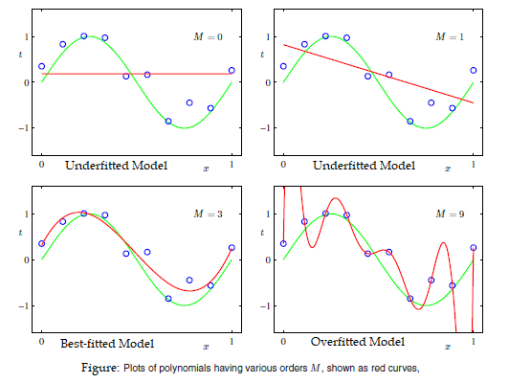
Overfitting and Underfitting

Slide 53
Performance Measures of Classification
Before selecting a classification algorithm to solve a problem, we need to evaluating its performance. Confusion matrix is widely used for computing performance measures of classification algorithm.
A Confusion matrix is an N x N matrix used for evaluating the performance of a classification model, where N is the number of target classes.
The matrix compares the actual target values with those predicted by the machine learning model. This gives us a holistic view of how well our classification model is performing and what kinds of errors it is making.

Slide 54
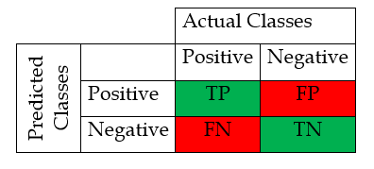
Performance Measures of Classification
For a binary classification problem, we would have a 2 x 2 matrix as shown below with 4 values:
True Positive(TP): It represents correctly classified positive classes. Both actual and predicted class are positive here.

Slide 55
Performance Measures of Classification
False Positive (FP): It represents incorrectly classified positive classes. These are the positive classes predicted by the model that were actually negative. This is called Type I error.
True Negative(TN): It represents correctly classified Negative classes. Both actual and predicted class are negative here.
False Negative (FN): It represents incorrectly classified negative classes. These are the negative classes predicted by the model that were actually positive. This is called Type II error.

Slide 56
Performance Measures of Classification
Four widely used performance measures used for evaluating classification models are: Accuracy, Recall, Precision, F1-score.
Accuracy: It is the percentage of correct predictions made by the model and is given as below:
Precision: It is percentage of predicted positives that are actually positive and is given by:

Slide 57
Performance Measures of Classification
Recall: It is the percentage of actual positives that are correctly classified by the model and is given as below:
F1-score: It is the harmonic mean of recall and precision. It becomes high only when both precision and recall are high. This score is given by:

Slide 58
Performance Measures of Classification
Example
Suppose that we have to classify 100 people as pregnant or not pregnant. This includes 40 pregnant women and the remaining 60 are not pregnant. Out of 40 pregnant women 30 pregnant women are classified correctly and the remaining 10 pregnant women are classified as not pregnant by the machine learning algorithm. On the other hand, out of 60 people in the not pregnant category, 55 are classified as not pregnant and the remaining 5 are classified as pregnant.
Compute accuracy, precision, recall, and F1-score for the above example.

Slide 59
Performance Measures of Classification
Solution

Slide 60
Parametric vs Non-parametric Algorithms
A parametric model is a learner that summarizes data through a collection of parameters.
These parameters are of a fixed-size. This means that the model already knows the number of parameters it requires.
The parameters are also independent of the number of training instances. With parametric models, there are two steps involved. The first is choosing the function form. Learning the function coefficients from training data is the second step.

Slide 61
Parametric vs Non-parametric Algorithms
The mapping function in the form of a linear regression line is an example of parametric model.
Algorithms that do not make particular assumptions about the kind of mapping function are known as non-parametric algorithms.
These algorithms do not accept a specific form of the mapping function between input and output data as true.

Slide 62
Parametric vs Non-parametric Algorithms
They have the freedom to choose any functional form from the training data.
As a result, for non-parametric models to estimate the mapping function they require much more data than parametric ones.
One might think that non-parametric means that there are no parameters. However, this is not true. Rather, it simply means that the parameters are (not only) adjustable but can also change.

Slide 63
Parametric vs Non-parametric Algorithms
In the case of non-parametric ones, the number of parameters is dependent on the amount of training data.
The more training data, the greater the number of parameters. A consequence of this is that non-parametric algorithms may take much longer to train.
K-nearest neighbors is an example of a non-parametric algorithm. Its predictions are based on the k most similar training patterns for a new instance of data.

Slide 64
Probabilistic Interpretation of Least Square Regression
Let us assume that the target variables and the inputs are related via the equation.
Where is an error term that captures either unmodeled effects or random noise.
Let us further assume that the are distributed IID (independently and identically distributed) according to a Gaussian distribution with zero mean and some variance σ2.

Slide 65
Probabilistic Interpretation of Least Square Regression
=>
The notation indicates that this is the distribution of y^{i}, given x^{i} and parameterized by W.
When we wish to explicitly view this as a function of W, we will instead call it the likelihood function

Slide 66
Gaussian Discriminant Analysis
There are two types of Supervised Learning algorithms used for classification in Machine Learning.
Discriminative Learning Algorithms
Generative Learning Algorithms
Discriminative Learning Algorithms include Logistic Regression, Perceptron Algorithm, etc. which try to find a decision boundary between different classes during the learning process.

Slide 67
Gaussian Discriminant Analysis
For example, given a classification problem to predict whether a patient has malaria or not a Discriminative Learning Algorithm will try to create a classification boundary to separate two types of patients, and when a new example is introduced it is checked on which side of the boundary the example lies to classify it.
Such algorithms try to model P(y|X) i.e. given a feature set X for a data sample what is the probability it belongs to the class ‘y’.

Slide 68
Gaussian Discriminant Analysis
On the other hand, Generative Learning Algorithms follow a different approach, they try to capture the distribution of each class separately instead of finding a decision boundary among classes.
Considering the previous example, a Generative Learning Algorithm will look at the distribution of infected patients and healthy patients separately and try to learn each of the distribution’s features separately.

Slide 69
Gaussian Discriminant Analysis
When a new example is introduced it is compared to both the distributions, the class to which the data example resembles the most will be assigned to it.
Such algorithms try to model P(X|y) for a given P(y) here, P(y) is known as a class prior.

Slide 70
Locally Weighted Regression
Linear regression is a supervised learning algorithm used for computing linear relationships between input (x) and output (y).
This algorithm cannot be used for making predictions when there exists a non-linear relationship between x and y. In such cases, locally weighted linear regression is used.
Locally weighted linear regression is a non-parametric algorithm, that is, the model does not learn a fixed set of parameters as is done in ordinary linear regression.

Slide 71
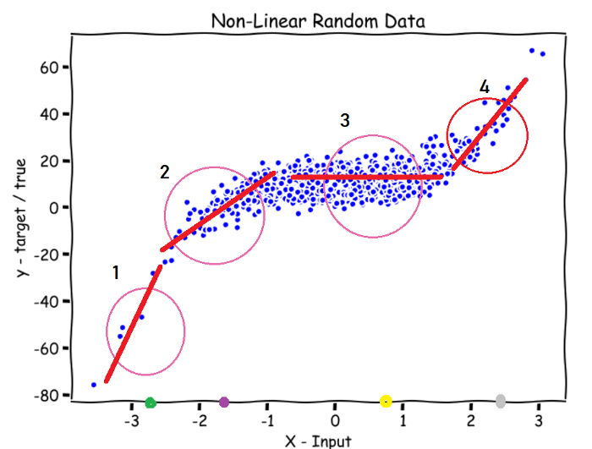
Locally Weighted Regression
Rather the parameters are computed individually for each query point x. While computing parameters a higher preference is given to the points in the training set lying in the vicinity of x than the points lying far away from x.

Slide 72
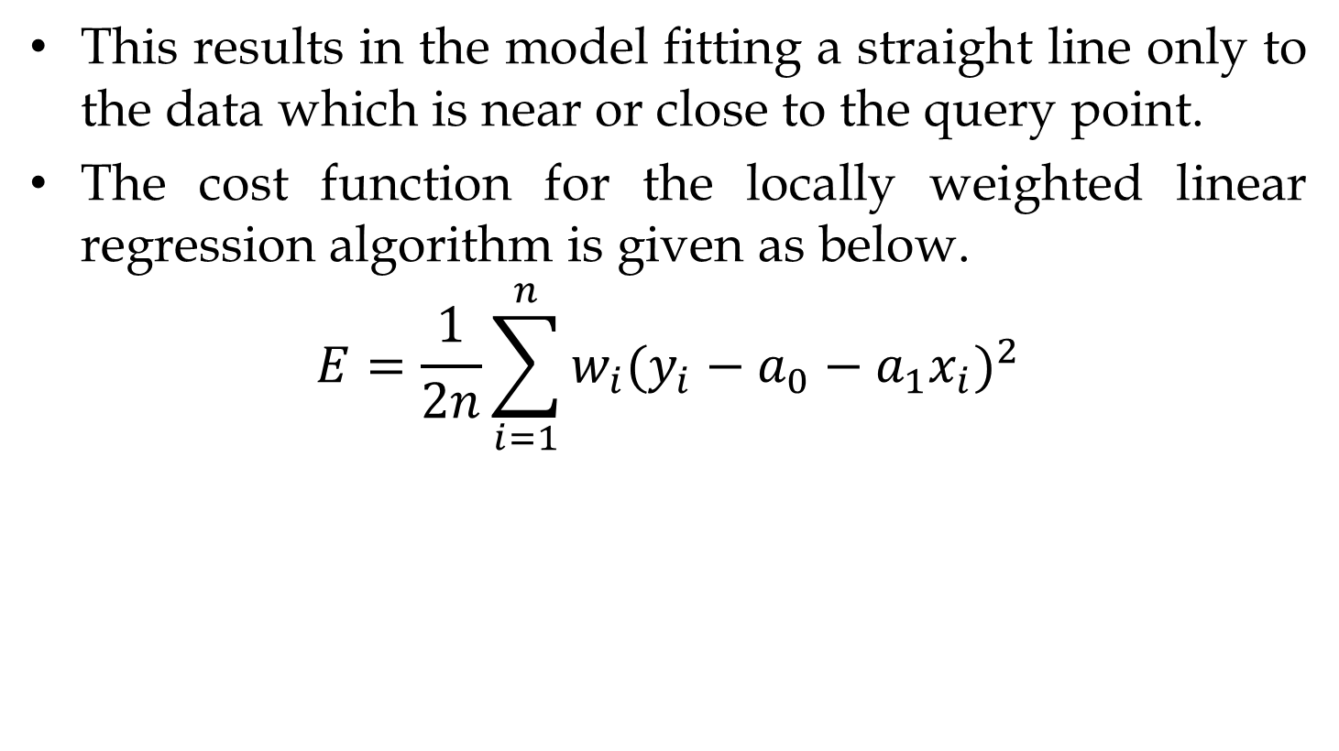
Locally Weighted Regression
This results in the model fitting a straight line only to the data which is near or close to the query point.
The cost function for the locally weighted linear regression algorithm is given as below.
$$E=\frac{1}{2n}\sum_{i=1}^{n}{{w_{i}({y_{i}−a}_{0}−a_{1}x_{i})}^{2}}$$

Slide 73
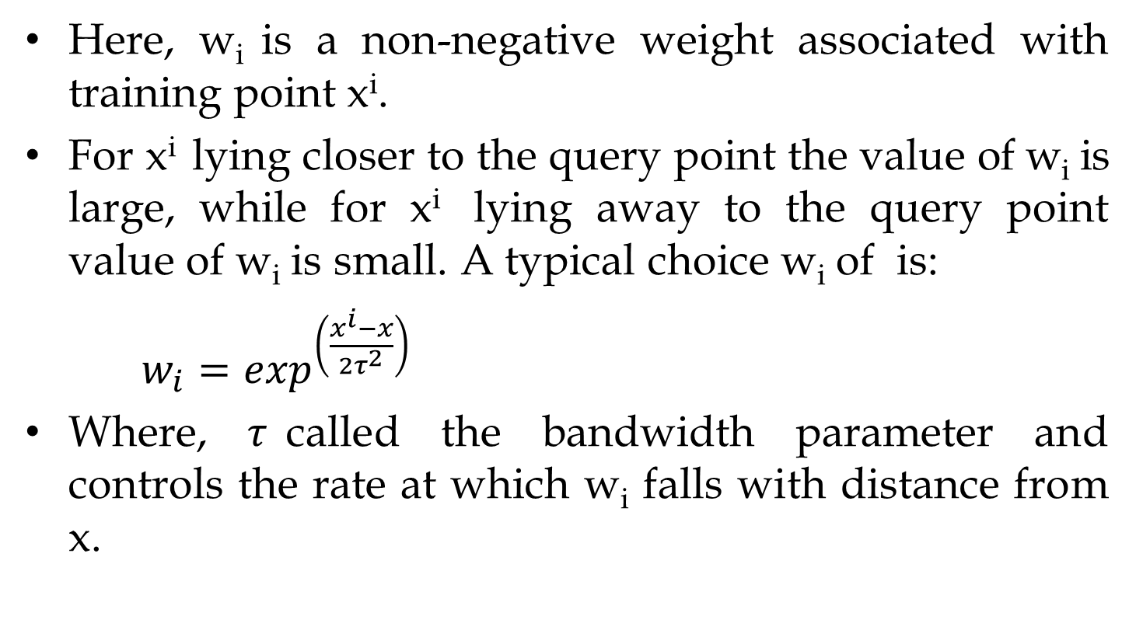
Locally Weighted Regression
Here, w_{i} is a non-negative weight associated with training point x^{i}.
For x^{i} lying closer to the query point the value of w_{i} is large, while for x^{i} lying away to the query point value of w_{i} is small. A typical choice w_{i} of is:
$w_{i}=\exp^{\left(\frac{x^{i}−x}{2τ^{2}}\right)}$
Where, $τ$called the bandwidth parameter and controls the rate at which w_{i} falls with distance from x.

Slide 74
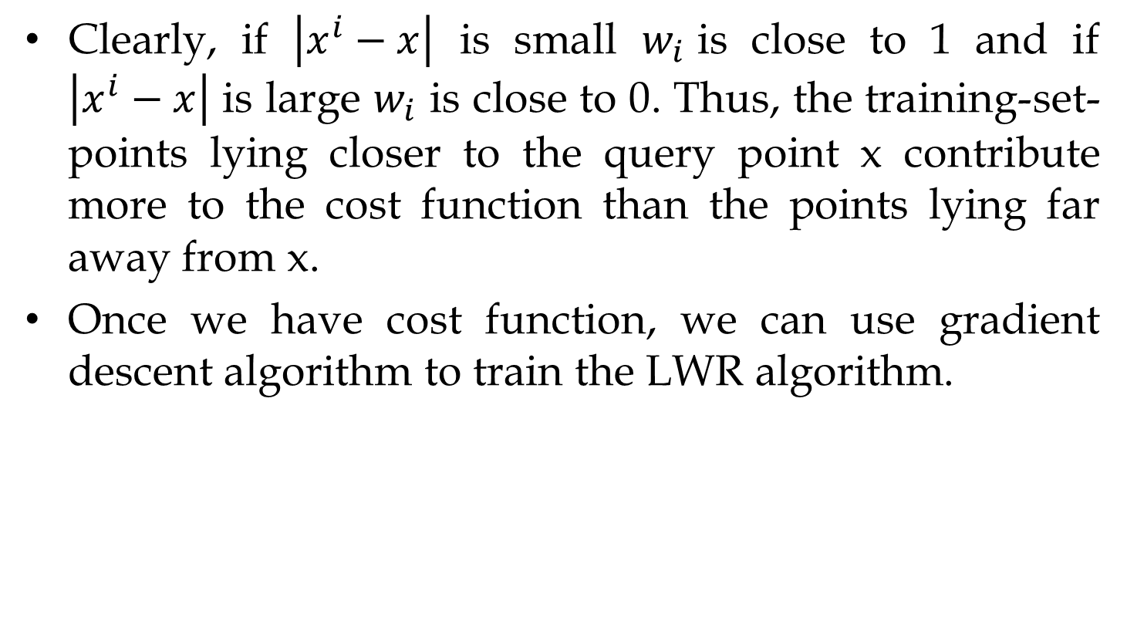
Locally Weighted Regression
Clearly, if $\left|x^{i}−x\right|$ is small $w_{i}$is close to 1 and if $\left|x^{i}−x\right|$ is large $w_{i}$ is close to 0. Thus, the training-set-points lying closer to the query point x contribute more to the cost function than the points lying far away from x.
Once we have cost function, we can use gradient descent algorithm to train the LWR algorithm.

Slide 75

Locally Weighted Regression
Example: Consider a query point x= 6 and let $x^{1}=5$, $x^{2}=4$, and $x^{3}=$3 are three points in the training set. Find Cost function for the Locally weighted linear regression.

Slide 76
Locally Weighted Regression
Example: Consider a query point x= 6 and let $x^{1}=5$, $x^{2}=4$, and $x^{3}=$3 are three points in the training set. Find Cost function for the Locally weighted linear regression.

Slide 77
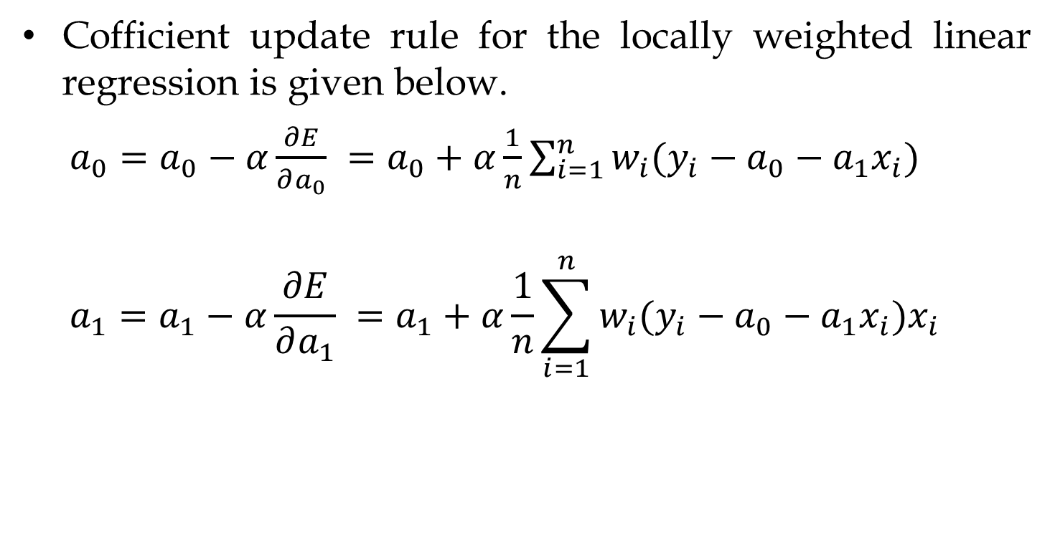
Locally Weighted Regression
Cofficient update rule for the locally weighted linear regression is given below.
$a_{0}=a_{0}−α\frac{∂E}{∂a_{0}} =a_{0}+α\frac{1}{n}\sum_{i=1}^{n}{{{w_{i}(y}_{i}−a}_{0}−a_{1}x_{i}})$
$$a_{1}=a_{1}−α\frac{∂E}{∂a_{1}} =a_{1}+α\frac{1}{n}\sum_{i=1}^{n}{{{w_{i}(y}_{i}−a}_{0}−a_{1}x_{i}})x_{i}$$

Slide 78
Bayesian Classification
Bayesian classification is based on Bayes’ theorem. It is also called Naïve Bayes Classification or Naïve Bayesian Classification. Bayes Theorem is given by:
Bayes’ theorem is useful in that it provides a way of calculating the posterior probability, P(H|X), from P(H), P(X|H), and P(X). Here P(X) and P(H) are prior probability.

Slide 79
Bayesian Classification
Let D be a database and C₁,C₂……C_{m} are m classes. Now above Bayes rule can be written as:
Given a tuple, X, the classifier will predict that X belongs to the class having the highest posterior probability, conditioned on X. Thus we need to maximize P(C_{i}|X). As P(X) is constant for all classes, only P(X|C_{i})P(C_{i}) need to be maximized.

Slide 80
Bayesian Classification
Let X is the set of attributes {x₁, x₂, x₃…….x_{n}} where attributes are independent of one another. Now the probability P(X|C_{i}) is given by the equation given below:

Slide 81
Bayesian Classification
Predict class level of the tuple: X = (age = youth, income = medium, student = yes, credit_rating = fair) using Bayesian classification.
Example

Slide 82
Bayesian Classification
Solution
Prior probability of each class can be computed based on the training tuples:
Compute the following conditional probabilities:

Slide 83
Bayesian Classification

Slide 84
Bayesian Classification
Solution
Using the above probabilities, we obtain
P(X|buys_computer=yes)=P(age=youth|buys_computer=yes) ×P(income=medium|buys_computer=yes)×P(student=yes| buys_computer=yes)×P(credit_rating=fair|buys_computer=
yes)= 0.222×0.444×0.667×0.667 = 0.044
P(X|buys computer=no) =P(age=youth|buys_computer= no)×P(income=medium|buys_computer=no)× P(student= yes|buys_computer=no)×P(credit_rating=fair| buys_computer=no)= 0.6*0.4*0.2*0.4 = 0.019

Slide 85
Bayesian Classification
Solution
Now,
P(buys_computer=yes|X)=P(X|buys_computer=
yes) × P(buys_computer=yes)= 0.044*0.643 = 0.028
P(buys_computer=no|X)=P(X|buys_computer=no) ×P(buys_computer=no)= 0.019*0.357 = 0.007
Since
P(buys_computer=yes|X)> P(buys_computer=no|X),
Prediction for Given X is: buys_computer = yes.

Slide 86
Classification by Decision Tree Induction
Decision tree induction is the learning of decision trees from class labeled training tuples.
Decision tree is a flowchart-like tree structure where internal nodes (non leaf node) denotes a test on an attribute, branches represent outcomes of tests, and Leaf nodes (terminal nodes) hold class labels.

Slide 87
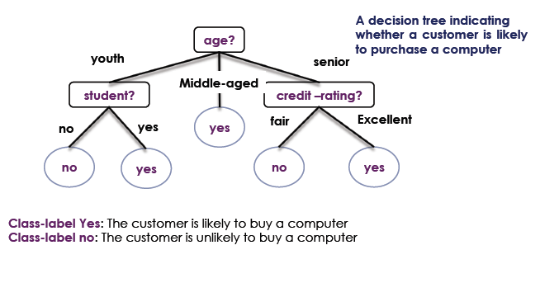
Classification by Decision Tree
In order to make prediction for a tuple, the attributes of a tuple are tested against the decision tree. A path is traced from the root to a leaf node which determines the predicted class for that tuple.

Slide 88
Classification by Decision Tree
Algorithm for Constructing Decision Tress
Constructing a Decision tree uses greedy algorithm. Tree is constructed in a top-down divide-and-conquer manner.
At start, all the training tuples are at the root
Tuples are partitioned recursively based on selected attributes
If all samples for a given node belong to the same class
Label the class
Else if there are no remaining attributes for further partitioning
Majority voting is employed for assigning class label to the leaf
Else
Got to step 2

Slide 89
Classification by Decision Tree
There are many variations of decision-tree algorithms. Some of them are: ID3 (Iterative Dichotomiser 3), C4.5 (successor of ID3), CART (Classification and Regression Tree) etc.
There are different attribute selection measures used by decision tree classifiers. Some of them are: Information Gain, Gain Ratio, Gini Index etc.

Slide 90
ID3 Decision Tree
ID3 stands for Iterative Dichotomiser 3. It uses top-down greedy approach to build decision tree model.
This algorithm computes information gain for each attribute and then selects the attribute with the highest information gain.
Information gain measures reduction in entropy after data transformation. It is calculated by comparing entropy of the dataset before and after transformation.

Slide 91
ID3 Decision Tree
Entropy is the measure of homogeneity of the sample. Entropy or expected information of dataset D is calculated by using equation 1.
Where p_{i} is the probability of a tuple in D belonging to class C_{i} and is estimated using Equation 2.
Where is the number of tuples in D belonging to class C_{i} and is the number of tuples in D.

Slide 92
ID3 Decision Tree
Suppose we have to partition the tuples in D on some attribute A having v distinct values. The attribute A can be used to split D into v partitions {D₁,D₂,..,D_{v}}. Now, the total entropy of data partitions while partitioning D around attribute A is calculated using Equation 3.
Finally, the information gain achieved after partitioning D on attribute A is calculated using Equation 4.

Slide 93
ID3 Decision Tree
Example
Construct decision tree from above data using information gain.
Predict class level of the tuple: X = (age = youth, income = medium, student = yes, credit_rating = fair)

Slide 94
ID3 Decision Tree
Solution
Expected information needed to classify a tuple in D is:
Expected information needed to classify a tuple in D if the tuples are partitioned according to age is:

Slide 95
ID3 Decision Tree
Solution
Hence, the gain in information from such a partitioning would be
Similarly,

Slide 96
ID3 Decision Tree
Solution
Similarly, we can get
Gain (student) = 0.151
Gain (credit_rating) = 0.048.
Because age has the highest information gain among the attributes, it is selected as the splitting attribute. The Decision tree now Looks like below.
Notice that the tuples falling into the partition for age D middle aged all belong to the same class. Because they all belong to class “yes” a leaf should therefore be created at the end of this branch and labeled “yes”.

Slide 97
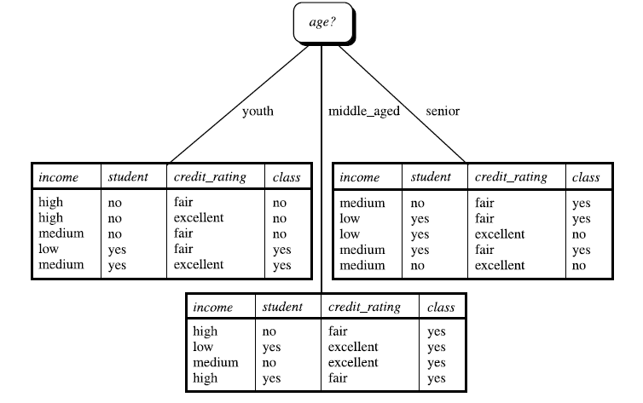
ID3 Decision Tree

Slide 98
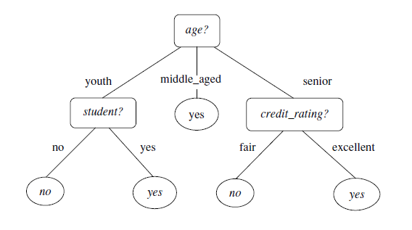
ID3 Decision Tree
Similarly, Compute Gain(Inclome), gain(Student), Gain(Credit_Rating) in case of left and right children. And repeat the above process. The final decision tree looks like below.

Slide 99
ID3 Decision Tree
Given Test tuple: X = (age = youth, income = medium, student = yes, credit_rating = fair)
Thus, The predicted class for the given data is: Buy_Computer=Yes

Slide 100
K-Nearest Neighbors Classifier
K-NN is a non-parametric and lazy learning algorithm. Non-parametric means the model structure determined from the dataset.
Lazy algorithm means it does not need any training data points for model generation. All training data used in the testing phase. This makes training faster and testing phase slower and costlier.
In K-NN, K is the number of nearest neighbors. The number of neighbors is the core deciding factor.

Slide 101
K-Nearest Neighbors Classifier
K-NN algorithm computes similarity between the new data and training data, finds K nearest neighbors, and finally puts new data into the class that is most similar.
Similarity is calculated by using Minkowski distance, which is a generalization of both Euclidean distance and Manhattan distance. It is defined as:
It represents the Manhattan distance when p = 1 (i.e., L₁ norm) and Euclidean distance when p = 2 (i.e., L₂ norm).

Slide 102
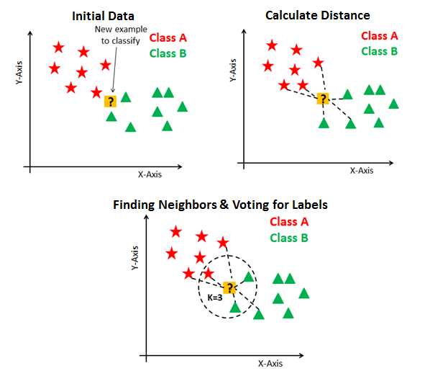
K-Nearest Neighbors Classifier
Assign new data to class B

Slide 103
K-Nearest Neighbors Classifier
Algorithm
Decide the value of K
Calculate Euclidean distance between new example and examples in training set.
Take the K nearest neighbors
Among these k neighbors, count the number of the data points in each category/class.
Assign the new data points to that category for which the number of the neighbor is maximum.

Slide 104
K-Nearest Neighbors Classifier
To select the K that’s right for your data, we run the KNN algorithm several times with different values of K and choose the K at which accuracy is highest.
As we decrease the value of K to 1, our predictions become less stable. Imagine K=1 and we have a data point surrounded by several members of class A and one member of class B. Since K=1, KNN predicts that the data point lies in class B.

Slide 105
K-Nearest Neighbors Classifier
Inversely, as we increase the value of K, our predictions become more stable due to majority voting / averaging, and thus, more likely to make more accurate predictions (up to a certain point). Eventually, we begin to witness an increasing number of errors. It is at this point we know we have pushed the value of K too far.

Slide 106
K-Nearest Neighbors Classifier
Example: Consider the following data points and find class label of last data point using KNN classifier.
Sepal Length | Sepal Width | Species (Class)
5.3 | 3.7 | Setosa
5.1 | 3.8 | Setosa
5.4 | 3.4 | Setosa
7.2 | 3.0 | Verginica
7.4 | 2.8 | Verginica
5.8 | 2.7 | Verginica
6.1 | 2.8 | Versicolor
6.3 | 2.3 | Versicolor
5.5 | 2.4 | Versicolor
5.2 | 3.1 | ?

Slide 107
K-Nearest Neighbors Classifier
Solution: Distance between new data and training data is given below. Assume K=5.
Sepal Length | Sepal Width | Species (Class) | Distance
5.3 | 3.7 | Setosa | 0.61
5.1 | 3.8 | Setosa | 0.71
5.4 | 3.4 | Setosa | 0.36
7.2 | 3.0 | Verginica | 2.00
7.4 | 2.8 | Verginica | 2.22
5.8 | 2.7 | Verginica | 0.72
6.1 | 2.8 | Versicolor | 0.95
6.3 | 2.3 | Versicolor | 1.36
5.5 | 2.4 | Versicolor | 0.76

Slide 108
K-Nearest Neighbors Classifier
From the table we can clearly see that out of 5 nearest neighbors votes are as below.
Setosa=3
Verginica=1
Versicolor=1
From this observation we can predict that the given data belongs to Setosa class.

Slide 109
Support Vector Machine
Support Vector Machine or SVM is one of the most popular Supervised Learning algorithms, which is used for Classification as well as Regression problems.
However, primarily, it is used for Classification problems in Machine Learning.
A support vector machine takes input data points and outputs the hyperplane (which in two dimensions it’s simply a line) that best separates the data points into two classes.

Slide 110
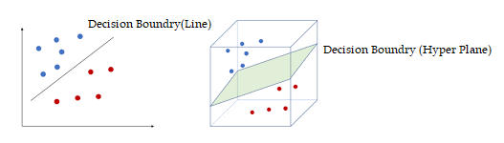
Support Vector Machine
This line or hyperplane is the decision boundary: any data points that falls to one side of it is classified in one class and, and the data points that falls to the other of it is classified in another class.

Slide 111
Support Vector Machine
Compared to newer algorithms like neural networks, they have two main advantages: higher speed and better performance with a limited number of samples (in the thousands).
Support vectors are data points that are closest to the hyperplane and influence the position and orientation of the hyperplane.
To separate the two classes of data points, there are many possible hyperplanes that could be chosen.

Slide 112
Support Vector Machine
SVM algorithm selects optimal hyperplane by choosing hyperplane with largest margin. Such hyperplane is called maximum marginal hyperplane (MMH).
Let H1 and H2 are planes that passes through support vectors and parallel to the hyperplane of decision boundary.

Slide 113
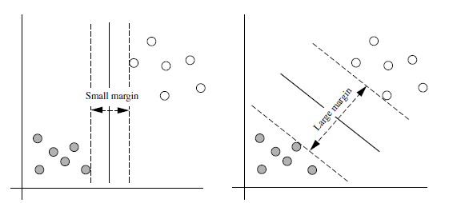
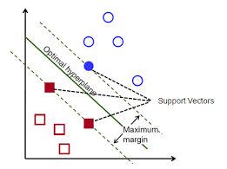
Support Vector Machine
Distance between plane H1 and the hyperplane should be equal to distance between plane H2 and the hyperplane. Margin is the distance between planes H1 and H2.

Slide 114
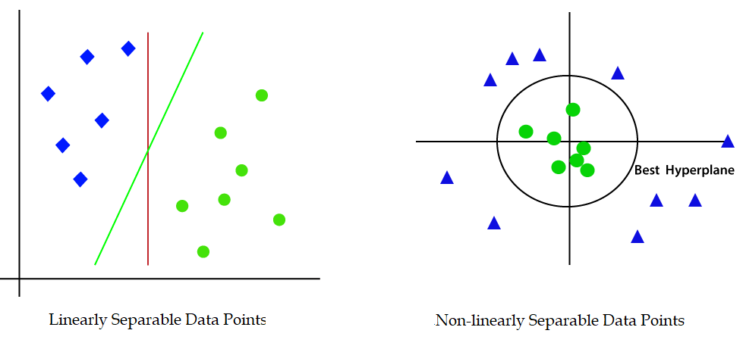
Support Vector Machine
Support Vector Machine(SVM) can be of two types: Linear SVM and Non-linear SVM.
SVM that is used to classify linearly separable data points is called linear SVM whereas the SVM that is used to classify non-linearly separable data points is called non-linear SVM.

Slide 115
Support Vector Machine
Non-linear SVM works in following two steps:
It transforms low–dimensional data points into high-dimensional data points, that are linearly separable, by using kernel-trick.
Then, it classifies data points using linear-hyperplane.
SVM algorithms use a set of mathematical functions that are defined as the kernel.
These functions are used to transform non-linearly separable low-dimensional data points into linearly separable high-dimensional data points.

Slide 116
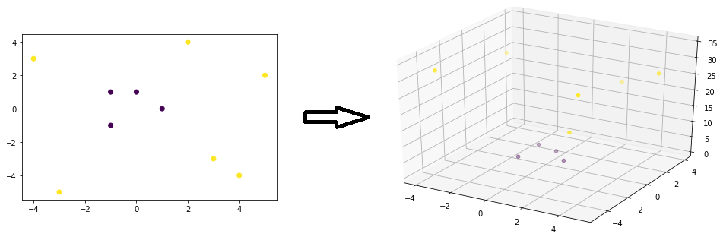
Support Vector Machine
Popular kernels are: Linear Kernel, Polynomial Kernel, Gaussian Kernel, Radial Basis Function (RBF), Sigmoid Kernel, etc.
Consider the following 2-D data points which are linearly inseparable. We can transform the data points into linearly separable data points by adding third dimension z=x²+y².

Slide 117
Support Vector Machine
Example
Consider following data points:
Positively Labelled Data Points:(3,1),(3,-1),(6,1),(6,-1)
Negatively Labelled Data Points:(1,0),(0,1),(0,-1),(-1,0)
Determine the equation of hyperplane that divides the above data points into two classes.
Then predict the class of data point (5,2).

Slide 118
Support Vector Machine
Solution
Support vectors are
s1=(1,0), s2=(3,1), s3=(3,-1) why???
Augment support vectors with b=1
s1=(1,0,1), s2=(3,1,1), s3=(3,-1,1)

Slide 119
Support Vector Machine
Solution
Since there are three support vectors, we need to calculate three variables
Thus, three linear equations can be written as:
After simplifying above equations, we get

Slide 120
Support Vector Machine
Solution
After simplifying above equations, we get
Solving these equations, we get
Now, we can compute weight vector of hyperplane as below

Slide 121
Support Vector Machine
Solution
Thus,
Hence, equation of hyper plane that divides data points is
x-2=0 How?
Data point to be classified is (5,2)
Putting this data point is above equation we get,
5-2=3
Thus the data point (5,2) belongs to +1 (Positively) class

Slide 122
Random Forest Classifier
Random Forest is a popular machine learning algorithm that belongs to the supervised learning technique.
It can be used for both Classification and Regression problems in ML.
It is based on the concept of ensemble learning, which is a process of combining multiple classifiers to solve a complex problem and to improve the performance of the model.

Slide 123
Random Forest Classifier
Since the random forest combines multiple trees to predict the class of the dataset, it is possible that some decision trees may predict the correct output, while others may not. But together, all the trees predict the correct output.
Each individual tree in the random forest spits out a class prediction and the class with the most votes becomes our model’s prediction.

Slide 124
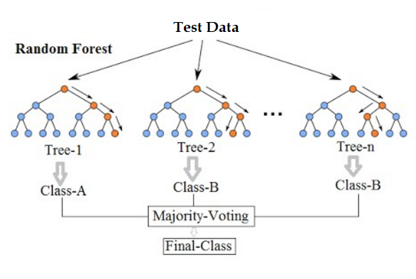
Random Forest Classifier

Slide 125
Random Forest Classifier
The fundamental concept behind random forest is: A large number of relatively uncorrelated models (trees) operating as a committee will outperform any of the individual constituent models.
The low correlation between models is the key of random forest classifier.
Randomness is ensured in random forest classifier by using two methods: Bagging, Feature randomness.

Slide 126
Random Forest Classifier
Bagging (Bootstrap Aggregation)
Decisions trees are very sensitive to the data they are trained on small changes to the training set can result in significantly different tree structures.
Random forest takes advantage of this by allowing each individual tree to randomly sample from the dataset with replacement, resulting in different trees. This process is known as bagging.

Slide 127
Random Forest Classifier
Notice that with bagging we are not subsetting the training data into smaller chunks and training each tree on a different chunk.
Rather, if we have a sample of size N, we are still feeding each tree a training set of size N. But instead of the original training data, we take a random sample of size N with replacement.
For example, if our training data was [1, 2, 3, 4, 5, 6] then we might give one of our trees the following list [1, 2, 2, 3, 6, 6].

Slide 128
Random Forest Classifier
Feature Randomness
In a normal decision tree, when it is time to split a node, we consider every possible feature and pick the one that produces the most separation between the observations in the left node vs. those in the right node.
In contrast, each tree in a random forest can pick only from a random subset of features. This forces even more variation amongst the trees in the model and ultimately results in lower correlation across trees and more diversification.

Slide 129
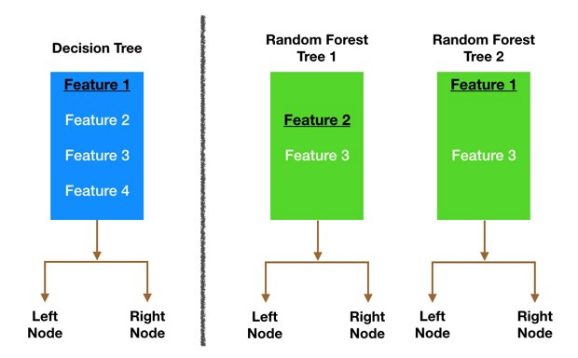
Random Forest Classifier

Slide 130
ID3 Decision Tree
Example
Construct random forest having 3 decision trees three by using feature sample {age, income} {age, student} and {Income, Student}.
Predict class level of the tuple: X = (age = youth, income = medium, student = yes)

Slide 131
Bias Variance Tradeoff
The prediction error for any machine learning algorithm can be broken down into three parts:
Bias Error
Variance Error
Irreducible Error
The irreducible error cannot be reduced regardless of what algorithm is used. It is the error introduced from the chosen framing of the problem and may be caused by factors like unknown variables that influence the mapping of the input variables to the output variable.

Slide 132
Bias Variance Tradeoff
Bias is the difference between the average prediction of our model and the correct value which we are trying to predict.
Model with high bias pays very little attention to the training data and oversimplifies the model. It always leads to high error on training and test data.
Bias is the tendency of an estimator to pick a model for the data that is not structurally correct. For example, suppose that we use a linear regression model on a cubic function.

Slide 133
Bias Variance Tradeoff
Bias is caused by underfitting and is the result of simplifying assumptions made by a model to make the target function easier to learn.
Variance is taken as the variability of a model prediction for a given data point.
Model with high variance pays a lot of attention to training data and does not generalize on the data which it hasn’t seen before.
As a result, such models perform very well on training data but has high error rates on test data. Variance is the result of overfitting.

Slide 134
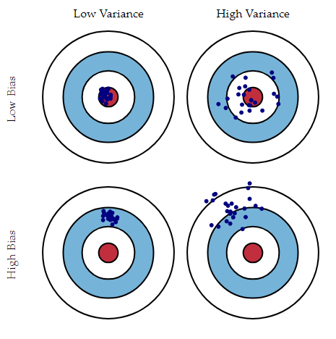
Bias Variance Tradeoff
Variance is error from sensitivity to small fluctuations in the training set. High variance can cause an algorithm to model the random noise in the training data, rather than the intended outputs

Slide 135
Bias Variance Tradeoff
If our model is too simple and has very few parameters then it may have high bias and low variance.
On the other hand if our model has large number of parameters then it’s going to have high variance and low bias. So we need to find the right/good balance without overfitting and underfitting the data. This keeps the MSE minimal.

Slide 136
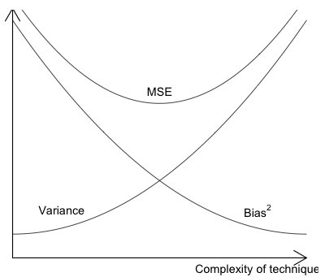
Bias Variance Tradeoff
Error

Slide 137
Ensemble Learning
Ensemble learning is a machine learning technique where multiple models are combined to solve the same problem.
It utilizes the advantages of multiple base models (weak learners) to compensate each models weakness.
The main principle behind ensemble learning is to group weak learners that achieves better performance than individual weak learner.

Slide 138
Ensemble Learning
Weak learners are the models that perform not so well by themselves either because they have a high bias or because they have a high variance.
Ensemble learning models can be categorized into two types based on the choice of weak learners: homogeneous and heterogeneous.
In homogeneous ensemble model, a single base learning algorithm is used whereas different base learning algorithms are used in heterogeneous ensemble model.

Slide 139
Ensemble Learning
Weak learners are the models that perform not so well by themselves either because they have a high bias or because they have a high variance.
Ensemble learning models can be categorized into two types based on the choice of weak learners: homogeneous and heterogeneous.
In homogeneous ensemble model, a single base learning algorithm is used whereas different base learning algorithms are used in heterogeneous ensemble model.
There are three popular methods of combining weak learners: Bagging, Boosting, and Stacking.

Slide 140
Ensemble Learning
Bagging
Bagging is also called Bootstrap Aggregation and aims to produce ensemble model that has less variance than its components .
It first learns several homogeneous weak learners with high variance and then combines them using some averaging method.
In real-life scenarios, we don’t have multiple different training sets on which we can train our model separately and at the end combine their result. Here, bootstrapping comes into the picture.

Slide 141
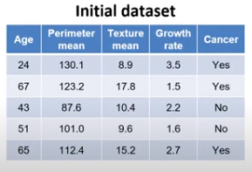
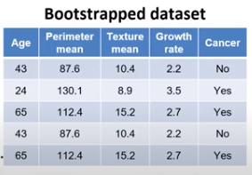
Ensemble Learning
Bagging
Bootstrapping is a technique of sampling different sets of data from a given training set by using replacement.

Slide 142
Ensemble Learning
Bagging
After bootstrapping the training dataset, we train the model on all the different sets and aggregate the result.
For regression problems outputs of individual weak learners are averaged to produce final result.
For classification problems class label predicted by each weak learner is considered as a vote and majority voting scheme is used for produces final prediction.

Slide 143
Ensemble Learning
Boosting
Boosting alto combines individual homogeneous weak learners to obtain a strong learner.
Boosting is mainly focused on reducing bias. This means weak learners having high bias are combined together to obtain model with reduced bias.
In boosting base models are trained sequentially (iteratively) whereas in bagging base models are trained in parallel.

Slide 144
Ensemble Learning
Boosting
Another important feature of boosting is that each model in the sequence is trained giving more importance to samples in the dataset that were incorrectly predicted by the previous models in the sequence.
Therefore each new model puts more effort on the most difficult samples.
AdaBoost, XGBoost, etc. are examples of boosting algorithms.

Slide 145
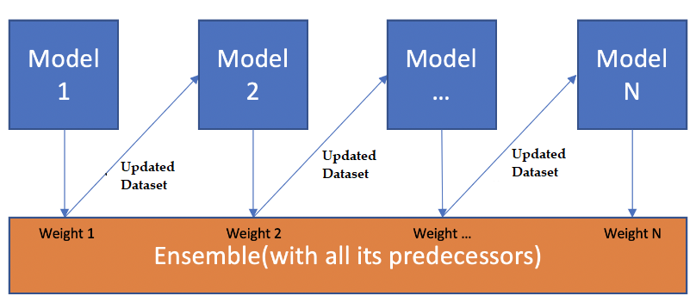
Ensemble Learning

Slide 146
Ensemble Learning
Stacking
Stacking often considers heterogeneous weak learners.
Stacking learns to combine the base models using a meta-model whereas bagging and boosting combine weak learners following deterministic algorithms.
In meta learning base level algorithms are trained based on a complete training data-set, the meta-model is trained on the final outcomes of the all base-level model as a feature.
Stacking aims to enhance prediction accuracy by reducing bias and variance.

Slide 147
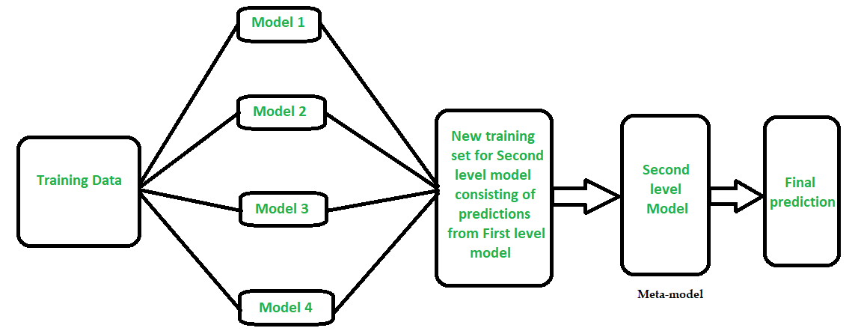
Ensemble Learning
Stacking

Slide 148
Ensemble Learning
Stacking
Suppose we want to fit a stacking ensemble composed of L weak learners. Then we have to follow the steps thereafter:
Split the training data in two folds.
Choose L weak learners and fit them to data of the first fold.
For each of the L weak learners, make predictions for observations in the second fold.
Fit the meta-model on the second fold, using predictions made by the weak learners as inputs.

